Slide 1
IEEE-CIS Fraud Detection Using Genetic Algorithms
Optimizing Feature Selection for Imbalanced Financial Data
Vamsidhar Reddy Vundela,
Dawnena Key

Slide 2

Problem Statement
Fraud costs $4.7T annually (ACFE)
IEEE-CIS dataset:<1% fraud cases (590K transactions, 0.8% fraud).
Challenge: High-dimensional data (284 features) -> need efficient feature selection to improve detection accuracy

Slide 3

Dataset Overview
Source: IEEE-CIS Kaggle Dataset.
Key Files: train_transaction.csv, train_identity.csv
Data Merge using TransactionID to combine identity and transaction data.
WHY THIS DATASET?
Used in IEEE-CIS Fraud Detection Challenge – real-world fraud cases from financial transactions

Slide 4

Data Preprocessing
SMOTE Balancing Explanation
Original Data: 590K transactions, 0.8% fraud
Post-SMOTE: 50% fraud, 50% non-fraud (balanced)
Noise Reduction for Feature Selection
Removed redundant and highly correlated features
Focused don selecting informative attributes for GA
Preprocessing reduces noise, handles missing values, and structures the data for effective feature selection using Genetic Algorithms.

Slide 5
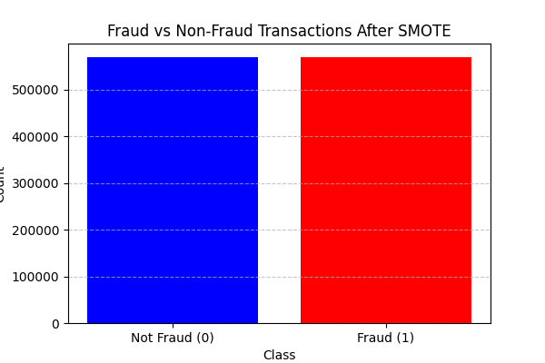
SMOTE Balancing Results
Why SMOTE?
Original data: 590K transactions, 0.8% fraud
Post-SMOTE: 50% fraud, 50% non-fraud (balanced)

Slide 6
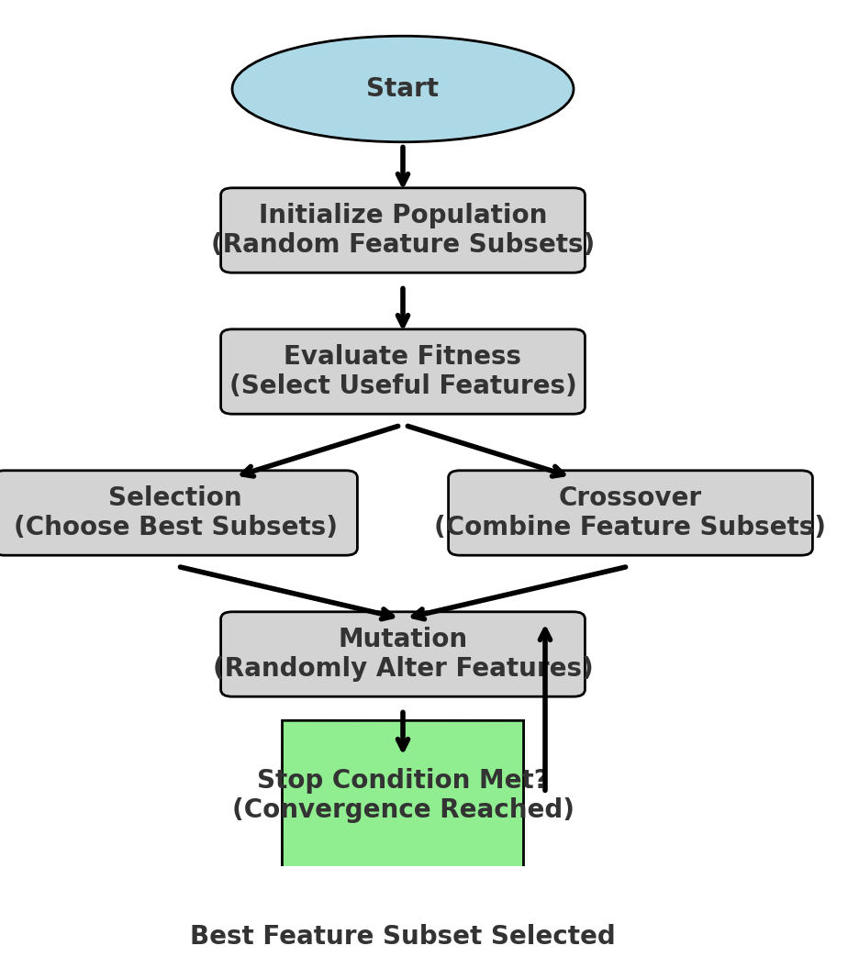
Genetic Algorithm Workflow
Population Initialization: Randomly selects feature sets.
Fitness Function: Measures subset usefulness.
Selection: Keeps best-performing feature subsets.
Crossover & Mutation: Generates new feature sets for optimization.
Final Selection: Saves the best feature subset.

Slide 7
Feature Selection Results
The dataset originally had 284 features. Using Genetic Algorithm (GA), the feature set was reduced to ~120 achieving 58% reduction
Key feature selected by GA: TransactionAmt, Vesta fields,DeviceType
Notes:
The dataset originally had 284 features.
After applying Genetic Algorithm (GA), the feature set was reduced to ~120, achieving a 58% reduction.
This helps in making the fraud detection model more efficient by eliminating redundant/noisy features
Key Features Selected by GA:
TransactionAmt – The amount of the transaction (high correlation with fraud).
Vesta fields – Proprietary features related to transaction authentication.
DeviceType – Important for identifying fraudulent transactions from unusual devices.

Slide 8
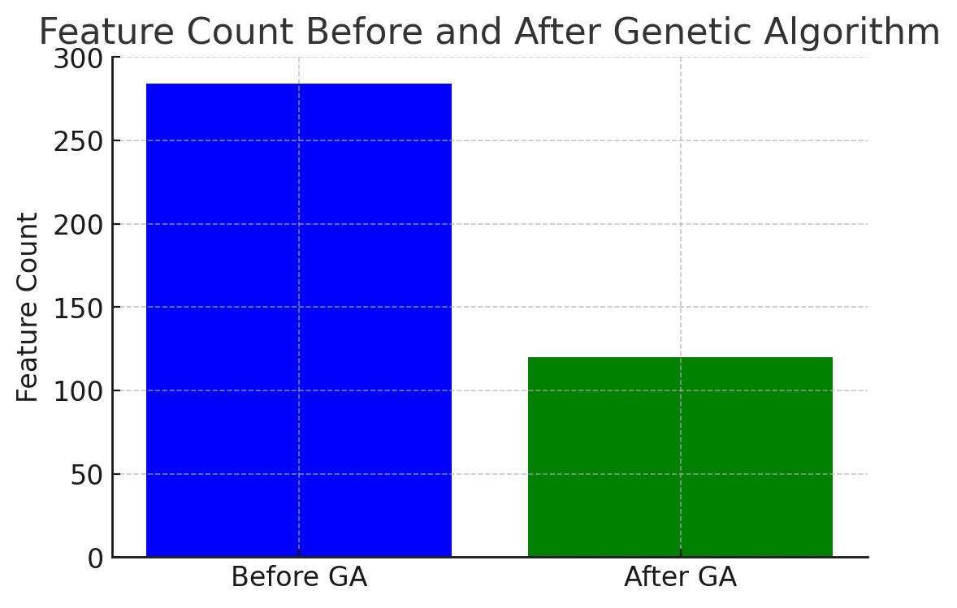

Slide 9
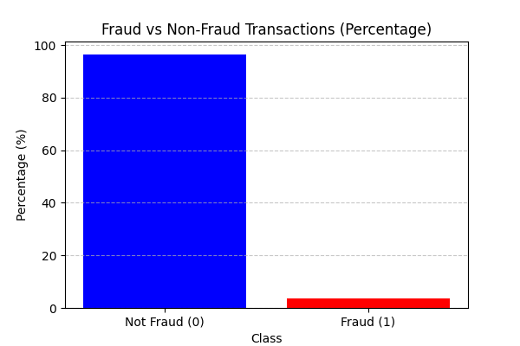
Fraud vs. Non-Fraud Distribution (post-SMOTE)
A bar chart was created to visualize the distribution of fraud and non-fraud transactions. The dataset was highly imbalanced before SMOTE, but after applying balancing techniques, the distribution became more suitable for training fraud detection models.

Slide 10

Genetic Algorithm Results
Reduced dataset complexity and computation time
Improves fraud detection interpretability by focusing on the most important features
Removes redundant/noisy variables, making future fraud detection models more effective

Slide 11
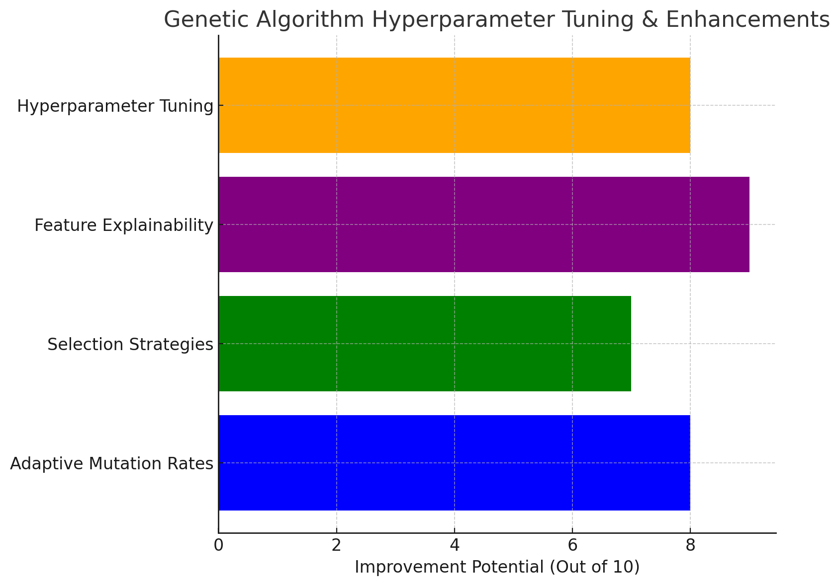
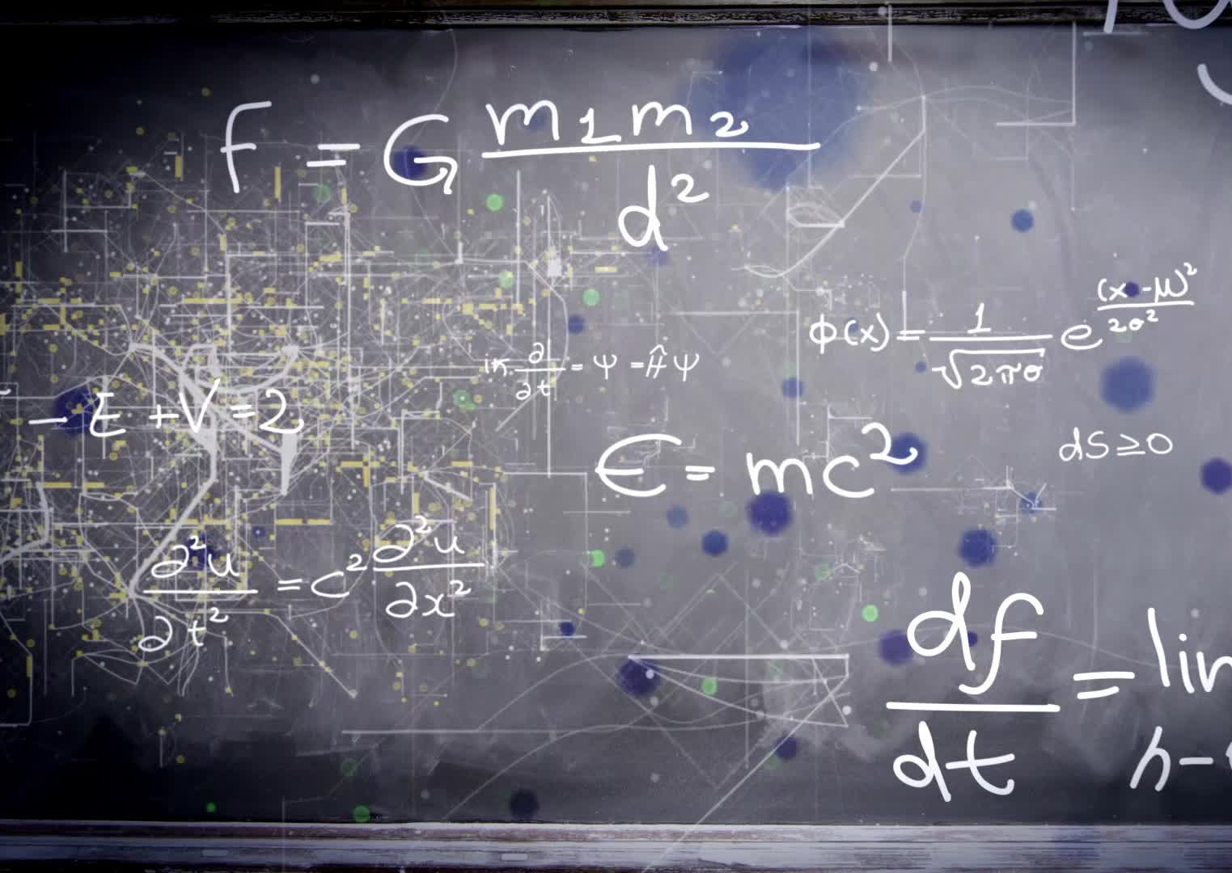
Future Enhancements
Adaptive mutation rates.
Optimized selection strategies
Explainability tools
Hyperparameter tuning
Notes:
Adaptive mutation rates: Dynamically adjust mutation rates to prevent premature convergence.
Optimized selection strategies: Experiment with different selection methods like roulette wheel, elitism, and rank selection to improve GA efficiency.
Explainability tools: Use SHAP (SHapley Additive Explanations) or LIME (Local Interpretable Model-agnostic Explanations) to interpret the selected features' impact on fraud detection.
Hyperparameter tuning: Optimize GA parameters like population size, crossover rate, and mutation rate for better performance.

Slide 12
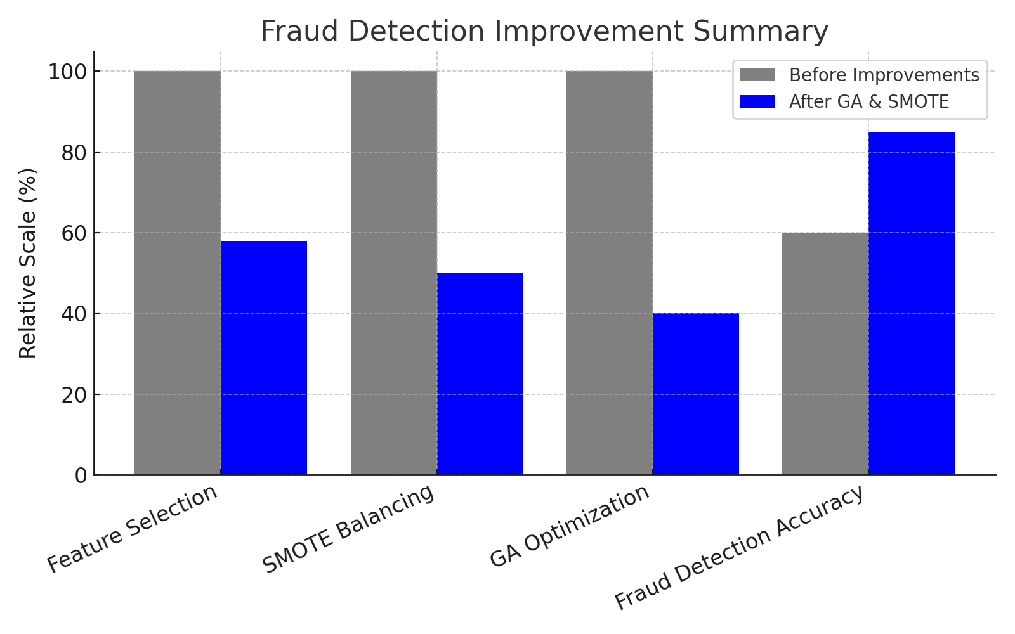
Conclusion
-GA reduced dataset dimensionality by 58%.
SMOTE effectively balanced the dataset
Key fraud detection features were successfully identified
The approach improves model interpretability and efficiency.
Notes:
GA achieved a 58% reduction in dataset dimensionality, improving model efficiency.
SMOTE effectively balanced the dataset, eliminating class imbalance and improving feature selection reliability.
Key fraud detection features were successfully identified, ensuring that only the most relevant variables are used for predictive modeling.
The approach improves model interpretability and efficiency, reducing processing costs for fraud detection.

Slide 13
Q&A
Thank You!

